Slide 1
Decentralized Computations by
Mobile Agents in Time-Varying Graphs
P. Flocchini
University of Ottawa

Slide 2
Decentralized Computations by
Mobile Agents in Time-Varying Graphs
joint work with
G.A. Di Luna, S. Dobrev, L. Pagli,
G. Prencipe, N. Santoro, G. Viglietta

Slide 3
DISTRIBUTED COMPUTING by COMPUTATIONAL ENTITIES
OPERATE AND MOVE IN A DISCRETE SPACE
Graph G = (V , E)
V nodes (sites , hosts)
E edges (links , channels)
called agents or robots

Slide 4
Discrete Space
( G , λ )
edge-labelled
2
1
Each node has a distinct
label for its links
3
x
4
port number

Slide 5
Each Agent
1+2 =3
Has computing capabilities
Has limited storage
Can move from node to neighboring node

Slide 6
The Agents
Have the same behavior
(execute the same protocol)
Collectively
they perform some task
(solve a problem)

Slide 7
Tasks / Problems
RendezVous/ Gathering
Exploration/ Map Construction
Black Hole Search
Decontamination
…

Slide 8
Tasks / Problems
RendezVous
Gathering

Slide 9
Tasks / Problems
RendezVous
Gathering
- strict

Slide 10
Tasks / Problems
RendezVous
Gathering
- strict
- near

Slide 11
Gathering in Discrete Space
Baston, Gal [Naval Log. Res. 91]
Alpern [SIAM J Cont. Optimization 95]
Anderson, Weber [J Applied Probability 99]
Yu, Yung [ICALP 96]
Alpern, Boston, Essegarer [J Appl. Probability 99]
Howard et al [Operation research 99]
Barrière, Flocchini, Fraigniaud, Santoro [SPAA 03]
Dessmark, Fraigniaud, Pelc [ESA 03]
Dobrev, Flocchini, Prencipe, Santoro [OPODIS 03]
Kranakis, Krizac, Santoro, Sawchuk [ICDCS 03]
Kowalski, Pelc [ISAAC 04]
Flocchini, Kranakis, Krizac, Santoro, Sawchuk [LATIN 04]
Dessmark, Fraigniaud, Kowalski, Pelc [Networks ‘06]
Kranakis, Krizank, Marcou [LATIN 06]

Slide 12
Gathering in Discrete Space
Barrière,Flocchini,Fraigniaud,Santoro [Theo.Comp.Sys. ‘07]
Chalopin [Theo.Comp.Sci.’08]
Czyzowicz, Dobrev, Kranakis, Krizanc [SOFSEM 08]
Klasing, Markou, Pelc [Theo.Comp.Sci.’08]
Kowalski, Mailnowski [Theo.Comp.Sci.’08]
Czyzowicz, Pelc, Labourel [ACM Trans. Alg.‘13]
D’Angelo, Di Stefano, Klasing, Navarra [Theo.Comp.Sci. ‘14]
Das, Luccio, Markou [ALGOSENSORS 15]
Dieudonne, Pelc, Villain [SIAM J. Comp. ’15]
Das, Luccio, Focardi, Markou, Moro, Squarcina [ICTCS 16]
Miller, Pelc [Dist. Comput. ’16]
Bouchard, Dieudonne, Ducourthial [Dist. Comput. ’16]
Dieudonne, Pelc [Algorithmica ’16]
De Marco,Gargano,Kranakis,Krizank,Pelc,Vaccaro [Theo. Comp. Sci. ’16]
E. Kranakis, D. Krizanc, E. MarcouThe Mobile Agent Rendezvous Problem in the Ring Morgan & Claypool, 2010
AND MANY MORE …

Slide 13
Tasks / Problems
Exploration
?

Slide 14
Exploration/Map Contruction
Shannon [JMF 51]
Blum, Kozen [FOCS 78]
Dudek, Jenkin, Milios, Wilkes [Robotics and Automation 91]
Bender, Slonim [FOCS 94]
Betke, Rivest, Singh [Machine Learning 95]
Bender, Fernandez, Ron, Sahai, Vadhan [STOC 98]
Deng, Papadimitriou [J. Graph Theory 99]
Panaite, Pelc [J. Algorithms 99]
Awerbuch, Betke, Rivest, Singh [Information and Comp. 99]
Panaite, Pelc [Networks 00]
Albers, Henzinger [SIAMJC 00]
Duncan, Kobourov, Kumar [SODA 01]

Slide 15
Exploration/Map Contruction
Diks, Fraigniaud,Kranakis, Pelc [J Algorithms 02]
Fraigniaud, Ilcinkas [STACS 04]
Fraigniaud, Ilcinkas, Peer, Pelc, Peleg [MFC S04]
Das, Flocchini, Nayak, Santoro [ISAAC 06]
Gasienic,Klansing,Martin,Navarra,Zhang [SIROCCO 07]
Das, Flocchini, Kutten, Nayak, Santoro [TCS 07]
Dessmarc, Pelc [ESA’02]
AND MANY MORE …

Slide 16
Gathering and Exploration in Discrete Space
Variety of assumptions and conditions
Agents with/without ids
Nodes with/without ids
With/without orientation
With/without tokens
With/without faults
A-priori knowledge of number of agents k
A-priori knowledge of number of nodes n
A-priori knowledge of network topology
…

Slide 17
Gathering and Exploration in Discrete Space
SHARED ASSUMPTION:
network is static

Slide 18
Gathering and Exploration in Discrete Space
network is dynamic

Slide 19
Dynamic Networks
network is dynamic
topology changes continuously & unpredictably

Slide 20
Dynamic Networks
network is dynamic
topology changes continuously & unpredictably
(under the control of an adversary)
possibly disconnected

Slide 21
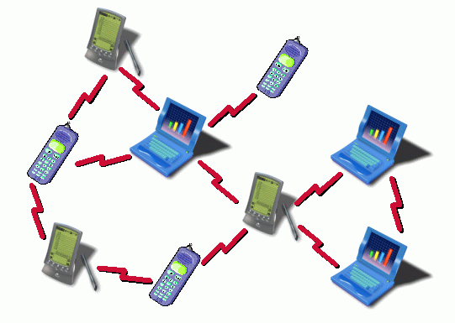
Dynamic Networks : WIRELESS MOBILE
mobile ad hoc networks (MANETS)

Slide 22
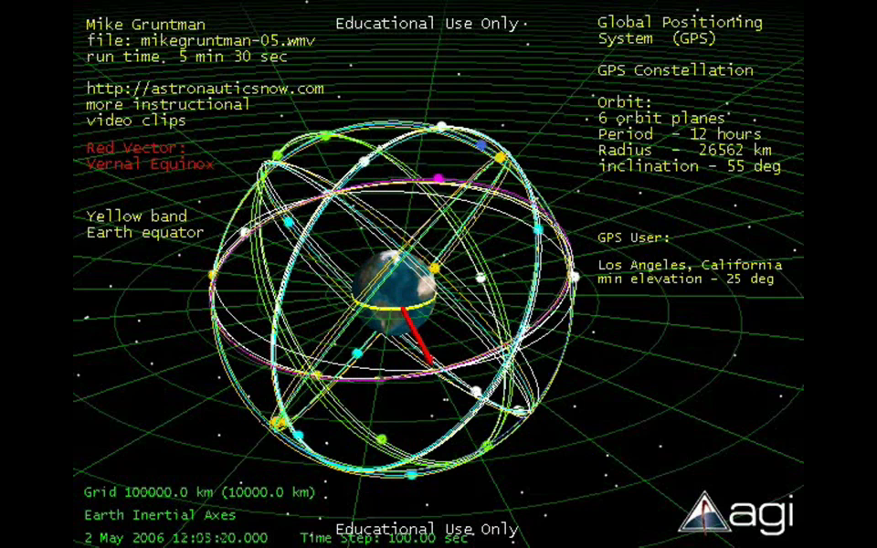
Dynamic Networks : LEO SATELLITE NETWORK
NYC transit (MTA)
Notes:
22

Slide 23
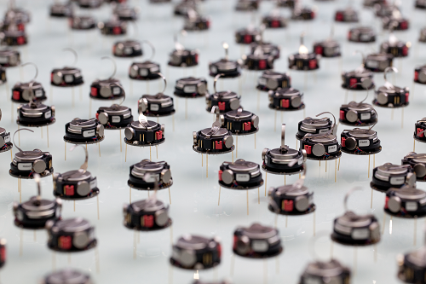
Dynamic Networks : ROBOTIC SWARMS

Slide 24
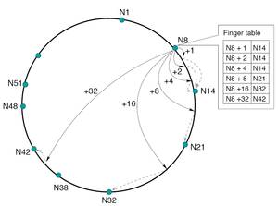
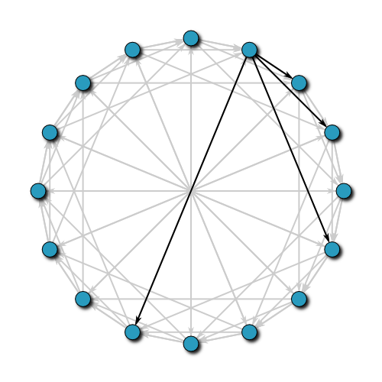
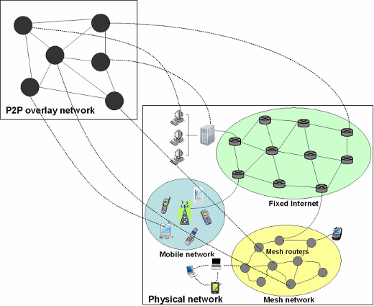
Dynamic Networks : PEER-TO-PEER
OVERLAY networks

Slide 25
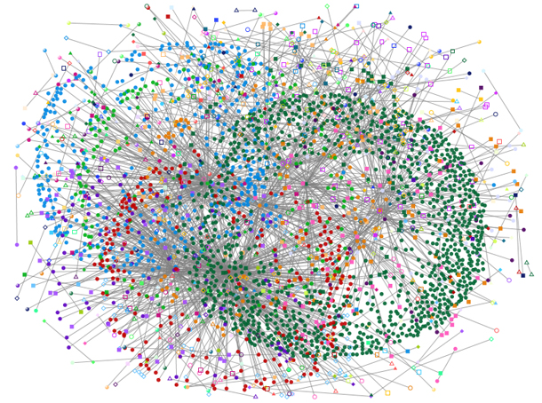
Dynamic Networks : SOCIAL NETWORKS/WEB GRAPHS
HOTMAIL

Slide 26
Dynamic Network
Modeled as TIME-VARYING GRAPH
A. Casteigts, P. Flocchini, W. Quattrociocchi, N.Santoro.
“Time-varying graphs and dynamic networks”. IJPEDS, 2012
A general mathematical formalism that describes many different types of dynamic networks
A model that includes most existing models as special cases

Slide 27
Time-Varying Graph
G = (N, E, T, ψ, ρ, ζ )

Slide 28
Time-Varying Graph
G = (N, E, T, ψ, ρ, ζ )
nodes

Slide 29
Time-Varying Graph
G = (N, E, T, ψ, ρ, ζ )
E ⊆ N × N
edges

Slide 30
Time-Varying Graph
G = (N, E, T, ψ, ρ, ζ )
lifetime of system (contiguous time span)
R
T ⊆

Slide 31
Time-Varying Graph
G = (N, E, T, ψ, ρ, ζ )
lifetime of system (contiguous time span)
R
T ⊆
Limited (finite)

Slide 32
Time-Varying Graph
G = (N, E, T, ψ, ρ, ζ )
lifetime of system (contiguous time span)
R
T ⊆
Unlimited (infinite)

Slide 33
Time-Varying Graph
G = (N, E, T, ψ, ρ, ζ )
lifetime of system (contiguous time span)
R
T ⊆
0
Unlimited (infinite)
beginning of time line

Slide 34
Time-Varying Graph
G = (N, E, T, ψ, ρ, ζ )
node presence function
ψ : N × T → {0, 1}
edge presence function
ρ : E × T → {0, 1}
ψ(x,t)=1 iff
x is in present at time t
ρ(e,t)=1 iff
e is present at time t

Slide 35
Time-Varying Graph
G = (N, E, T, ψ, ρ, ζ )
latency (duration) function ζ : E × T → T {⊥}
˛∩
ζ((x,y), t) = d
message from x to y, sent at time t, will arrive at time t+d
ζ((x,y), t) = ⊥
message from x to y, if sent at time t, will not arrive

Slide 36
Time-Varying Graph: Snapshot & Footprint
G = (N, E, T, ψ, ρ, ζ )
G(t) = (N(t) , E(t))
SNAPSHOT at time t ∈ T
N(t) = { x ∈ N : ψ(x, t)=1 }
E(t) = { e ∈ E : ρ(e, t)=1 }
G = (N , E)
FOOTPRINT
a-temporal
(underlying graph)
aggregate

Slide 37
Time-Varying Graph
G
G
0
t

Slide 38
Time-Varying Graph
G
G
t
past
future
present

Slide 39
Time-Varying Graph
G
G
known
unknown
t
past
future
present

Slide 40
Time-Varying Graph
Post Mortem
Off-line
Centralized
known
unknown
t
past
future
preent
present
collected data
to be analyzed

Slide 41
Time-Varying Graph
Post Mortem
Live
Off-line
On-line
Centralized
Decentralized
known
unknown
t
past
future
present

Slide 42
Time-Varying Graph
unknown
t
future
present

Slide 43
Time-Varying Graph
something must be known
t
future
present

Slide 44
Time-Varying Graph
ASSUMPTIONS
a-priori knowledge
oracle
something must be known
t
future
present

Slide 45
Time-Varying Graph: Common Assumption
FINITE FOOTPRINT G=(N,E)

Slide 46
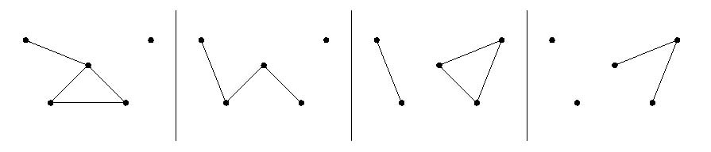
Time-Varying Graph: Common Assumption
SYNCHRONOUS
Time is divided in rounds
G(0) G(1) G(2) G(3) …
Evolving graph, Temporal graph, Multi-layer (multiplex)

Slide 47
Dynamic Networks
ASSUMPTIONS
DYNAMICS MODELS
(adversary)
- Temporal Connectivity
- 1-Interval Connectivity
- T-Interval Connectivity
F. Kuhn, N. Lynch, R. Oshman STOC 2010.
F. Kuhn, Y. Moses, R~Oshman. PODC 2011.
B. Haeuepler, F. Kuhn. DISC 2012
D. Ilcinkas, A.M. Wade. SIROCCO 2013
D. Ilcinkas, R. Klasing, A.M. Wade. SIROCCO 2014
- T. Erlerbach, M. Hoffmann, F. Kammer, ICALP 2015
G.A. Di Luna, S. Dobrev, P. Flocchini, N. Santoro. ICDCS 2016

Slide 48
1-Interval-Connectivity
SYNCHRONOUS
LOOK
Time is divided in rounds
round

Slide 49
1-Interval-Connectivity
1-INTERVAL CONNECTED
LOOK
Each G(i) contains a spanning-tree SPT(i) of G
G(i-1)
G(i)
G(i+1)
G(i+2)

Slide 50
1-Interval-Connectivity
1-INTERVAL CONNECTED
LOOK
Each G(i) contains a spanning-tree of G

Slide 51
T-Interval-Connectivity
T-INTERVAL CONNECTED
LOOK
Each G(i) contains a spanning-tree SPT(i) of G
G(i-1)
G(i)
G(i+1)
G(i+2)
SPT(i) persists for T rounds: i, i+1, i+2, …, i+T-1

Slide 52
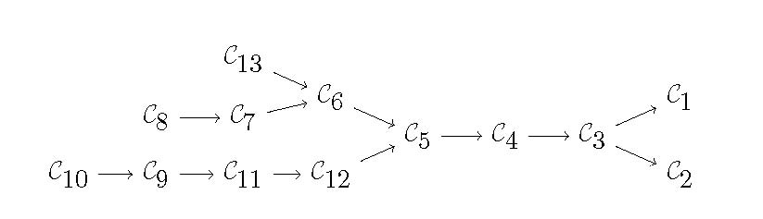
Time-Varying Graph
[Casteigts, et al. 2012]
TVG CLASSES
bounded recurrent
periodic
recurrent
always connected
connected over time
t-interval-connected

Slide 53
Dynamic Networks : Algorithmic Results
B.M.B. Xuan, A. F Ferreira, A. Jerry. “Computing shortest, fastest, and foremost Journeys in dynamic networks”. Int. J. Found. Comput. Sci. 2003
Kossinets, Kleinberg, Watts, “The structure of information pathways in a social communication network”. KDD 2008.
A. Casteigts, P. Flocchini, B.Mans, N. Santoro. “Measuring temporal lags in delay-tolerant networks”. IEEE Transactions on Computers, 2014
A. Casteigts, P. Flocchini, B. Mans, N. Santoro. “Shortest, fastest, and foremost broadcast in dynamic networks”. Int. J. Foundations of Computer Science, 2015
R. O’Dell and R. Wattenhofer. “Information dissemination in highly dynamic graphs”. DIALM-POMC 2005
A.Casteigts, S.Chaumette, A.Ferreira. “Characterizing Topological Assumptions of Distributed Algorithms in Dynamic Networks”, SIROCCO 2010
F. Kuhn, N. Lynch, and R. Oshman. “Distributed computation in dynamic networks”. STOC 2010.

Slide 54
Dynamic Networks : Algorithmic Results
A. Clementi, F. Pasquale. “ Information spreading in dynamic networks”. In: Theoretical Aspects of Distributed Computing in Sensor Networks, 2011.
H. Baumann, P. Crescenzi, P. Fraigniaud. “Parsimonious flooding in dynamic graphs”. Distributed Computing, 2011
F. Kuhn, R. Oshman, Y. Moses. “Coordinated consensus in dynamic networks”. PODC 2011.
B. Haeupler and F. Kuhn. “Lower bounds on information dissemination in dynamic networks”. DISC 2012.
L. Arantes, F. Greve, P. Sens, V. Simon. “Eventual leader election in evolving mobile networks”. OPODIS 2013
J. Augustine, G. Pandurangan, P. Robinson. “Fast Byzantine agreement in dynamic networks. PODC 2013.
E. Coulouma, E Godard. “A characterization of dynamic networks where consensus is solvable”. SIROCCO 2013

Slide 55
Dynamic Networks : Algorithmic Results
O. Michail, I. Chatzigiannakis, P. Spirakis. “Naming and counting in anonymous unknown dynamic networks”. SSS 2013.
H. Wu, J. Cheng, S. Huang, Y. Ke, Y. Lu, Y. Xu. “Path problems in temporal graphs”. VLDB 2014.
E.C. Akrida, L. Gasieniec , G.B. Mertzios, P. Spirakis. “Ephemeral networks with random availability of links”. SPAA 2014.
M. Antony, A. Gupta. “Finding a small set of high degree nodes in time- varying graphs”. WoWMoM 2014.
S. Huang, A.W.C. Fu, R Liu. “Minimum spanning trees in temporal graphs.
SIGMOD 2015.
A. Casteigts, R. Klasing, Y.M. Neggaz, J.G. Peters. “Efficiently Testing T -Interval Connectivity in Dynamic Graphs”. CIAC 2015.
T. Erlerbach, M. Hoffmann, F. Kammer. “On temporal Graph Exploration”, ICALP 2015.
And many more

Slide 56
Dynamic Networks : Algorithmic Results
Most of the Results
Some
Centralized
Decentralized
known
unknown
t
past
future
present

Slide 57
Focus of this talk
Most of the Results
Decentralized
Centralized
known
unknown
t
past
future
present

Slide 58
Focus of this talk
Most of the Results
Decentralized
Centralized
known
unknown
t
past
future
present

Slide 59
The Model: Dynamic Rings
1-INTERVAL CONNECTED
at each round, the adversary can remove one link
the adversary is possibly unfair (a link might be removed forever)
LOOK

Slide 60
The Model: Dynamic Rings
n nodes
k mobile agents
anonymous
silent
bounded memory
local orientation

Slide 61
The Model: Dynamic Rings
n nodes
k mobile agents
>>
anonymous
silent
bounded memory
local orientation
CHIRALITY
<<
>>
<<

Slide 62
The Model: Dynamic Rings
b
a
Each node has two
distinct ports

Slide 63
The Model: Dynamic Rings
b
b
a
a
When an agent arrives,
it arrives at a port

Slide 64
The Model: Dynamic Rings
b
b
a
a
If it decides not to move
(e.g. wait), it goes in the center

Slide 65
The Model: Dynamic Rings
It does not know if the link is up or not !
b
a
When an agent want to leave
it moves to the port
b
b
a
a

Slide 66
The Model: Dynamic Rings
It does not know if the link is up or not !
b
a
If the link is there, it arrives at the incident node in the next round

Slide 67
The Model: Dynamic Rings
It does not know if the link is up or not !
b
a
what if the edge
is missing ?

Slide 68
The Model: Dynamic Rings
It does not know if the link is up or not !
b
a
If the link is missing, it stays on the port until the next round

Slide 69
The Model: Dynamic Rings
FSYNC: all robots are activated in each round
b
a
LOOK-COMPUTE-MOVE
No communication (the agents are silent) !!!

Slide 70

The Model: Dynamic Rings
FSYNC: all robots are activated in each round
In a round
b
a
LOOK-COMPUTE-MOVE
See agents present at the node (center or on ports) and content of memory
Decide what to do (execute algorithm)
Possibly Move

Slide 71
The Model: Dynamic Rings
FSYNC: all robots are activated in each round
If …
then …
In a round
b
a
LOOK-COMPUTE-MOVE
See agents present at the node (center or on ports) and content of memory
Decide what to do (execute algorithm)
Possibly Move

Slide 72
The Model: Dynamic Rings
FSYNC: all robots are activated in each round
In a round
b
a
LOOK-COMPUTE-MOVE
See agents present at the node (center or on ports) and content of memory
Decide what to do (execute algorithm)
Possibly Move

Slide 73
Mobile Agents in Time-Varying Graphs
RENDEZVOUS/GATHERING
Has been studied only in STATIC graphs, and especially in the ring
E. Kranakis, D. Krizanc, E. Marcou
The Mobile Agent Rendezvous Problem in the Ring Morgan & Claypool, 2010

Slide 74
Mobile Agents in Time-Varying Graphs
RENDEZVOUS/GATHERING
G.A. Di Luna, P. Flocchini, G. Prencipe, L. Pagli, N. Santoro,
G. Viglietta. “Gathering in dynamic rings”. SIROCCO2017.

Slide 75
Gathering in Dynamic Rings
group
cross
CROSS DETECTION

Slide 76
GATHERING: BASIC LIMITATIONS
Because of dynamics
LOOK
T1
Strict Gathering is unsolvable in (R, A); this holds regardless of chirality, cross detection, and knowledge of k and n.
Strict/Near Gathering

Slide 77
GATHERING: BASIC LIMITATIONS
Because of dynamics
LOOK
T1
Strict Gathering is unsolvable in (R, A); this holds regardless of chirality, cross detection, and knowledge of k and n.
Even without dynamics
T2
Gathering is unsolvable in (R, A) if neither k nor n are known.
n nodes
n and/or k must be known
k agents

Slide 78
GATHERING: BASIC LIMITATIONS
Because of dynamics
LOOK
T1
Strict Gathering is unsolvable in (R, A); this holds regardless of chirality, cross detection, and knowledge of k and n.
Even without dynamics
T2
Gathering is unsolvable in (R, A) if neither k nor n are known.
T3
If the homebases are not distinguishable, then Gathering is unsolvable in (R, A); this holds regardless of chirality, cross
detection, and knowledge of k and n.
homebases are MARKED

Slide 79
Gathering in Dynamic Rings
(R, A)
either k or n known
homebase

Slide 80
Gathering in Dynamic Rings
(R, A)
CONFIGURATION
C
Set of all possible configurations

Slide 81
Gathering in Dynamic Rings
P
Set of all periodic configurations
CONFIGURATION
C
Set of all possible configurations

Slide 82
GATHERING: BASIC LIMITATIONS
Even without dynamics
LOOK
T4
Gathering is unsolvable in (R, A) if C ε P; this holds regardless of chirality, cross detection, and knowledge of k and n.
C is not periodic

Slide 83
Gathering in Dynamic Rings
A
Aperiodic configurations
(the only feasible ones in static)
CONFIGURATION

Slide 84
Gathering in Dynamic Rings
A
Aperiodic configurations
(the only feasible ones in static)
CONFIGURATION
Double palindromes

Slide 85
Gathering in Dynamic Rings
A
Aperiodic configurations
(the only feasible ones in static)
CONFIGURATION
E
Double palindromes with
edge-edge axis of symmetry

Slide 86
Gathering in Dynamic Rings
A
Aperiodic configurations
(the only feasible ones in static)
CONFIGURATION
E
Double palindromes with
edge-edge axis of symmetry

Slide 87
GATHERING: BASIC LIMITATIONS
Even without dynamics
LOOK
T4
Gathering is unsolvable in (R, A) if C ε P; this holds regardless of chirality, cross detection, and knowledge of k and n.
unsolvable
Because of dynamics
T5
Without cross-detection and without chirality Gathering is unsolvable in (R, A) if C ε E; this holds regardless of knowledge of k and n.
unsolvable

Slide 88
GATHERING: FEASIBILITY
chirality
no chirality
LOOK
A
A
cross detection
A
A \ E
no cross detection
With knowledge of n

Slide 89
GATHERING: FEASIBILITY
chirality
no chirality
LOOK
A
A
cross detection
A
A \ E
no cross detection
With knowledge of n

Slide 90
GATHERING: FEASIBILITY
chirality
no chirality
LOOK
A
A
cross detection
A
A \ E
no cross detection
With knowledge of n

Slide 91
GATHERING: FEASIBILITY
no chirality
LOOK
A
cross detection
A \ E
no cross detection
With knowledge of n

Slide 92
GATHERING: FEASIBILITY
chirality
no chirality
LOOK
A
A \ E
no cross detection
With knowledge of n

Slide 93
GATHERING: FEASIBILITY
chirality
no chirality
LOOK
A
A \ E
cross detection
A
A \ E
no cross detection
Knowledge of n
is more powerful
With knowledge of k only

Slide 94
GATHERING: FEASIBILITY
chirality
no chirality
LOOK
A
A \ E
cross detection
A
A \ E
no cross detection
With knowledge of k only

Slide 95
GATHERING: GENERAL SOLUTION STRUCTURE
Different strategies depending on
availability or lack of cross detection
useful to simplify termination in Phase 2
presence or absence of chirality
useful for breaking symmetries
LOOK

Slide 96
GATHERING: GENERAL SOLUTION STRUCTURE
Two phases
LOOK
Phase 1: The agents explore the ring
They might already solve Gathering. If so, they stop.
If not, the agents are able to elect a node or an edge and
proceed to Phase 2
Phase 2: The agents gather
They try to gather around the elected node or edge.
If that is not possible (due to the ring dynamics), gathering
occurs nevertheless at another place.

Slide 97
GATHERING: CROSS DETECTION - NO CHIRALITY
chirality
no chirality
LOOK
LOOK
A
A
cross detection
A
A \ E
no cross detection
With knowledge of n

Slide 98
With Cross Detection: Without Chirality
Phase 1: Exploration
Check-points
12n
rounds
0
6n
I find out important global
Information and I act accordingly
If we have not gathered,
I start Phase 2.
Move-left for 6n rounds
my left

Slide 99

With Cross Detection: Without Chirality
Phase 1: Exploration
Special Condition checked at round 6n:
round 6n
P: last time I met someone new going in my direction was less than
3n rounds ago; since then I traversed less than n links.
P true at round 6n means:
All agents moving in my direction form a single group; some may have not explored the whole ring; P is true for all of them.
P false at round 6n means:
All agents moving in my direction have explored the whole ring (hence they know k and the configuration), and P is false also for them.

Slide 100
With Cross Detection: Without Chirality
Phase 1: Exploration
Special Condition checked at round 6n:
round 6n
P: last time I met someone new going in my direction was less than
3n rounds ago; since then I traversed less than n links.
If P is true, I continue in the same direction for 6n more rounds
If P is false, I switch direction and move for 6n more rounds
During this time, I may TERMINATE if certain conditions occur

Slide 101
With Cross Detection: Without Chirality
Phase 1: Exploration
Move-left for 6n rounds
round 6n

Slide 102
With Cross Detection: Without Chirality
Phase 1: Exploration
P: last time I met someone new going in my direction was less than
3n rounds ago; since then I traversed less than n links.
round 6n
P false: everybody with my direction
has explored
P false: everybody with my direction
has explored
switch
switch
continue
P true: everybody
with my direction
is here

Slide 103
With Cross Detection: Without Chirality
Phase 1: Exploration
P: last time I met someone new going in my direction was less than
3n rounds ago; since then I traversed less than n links.
round 6n

Slide 104
With Cross Detection: Without Chirality
Phase 1: Exploration
Switch
Keep-moving in the new direction for 6n rounds
round 6n
Continue
Keep-moving left for 6n rounds

Slide 105
With Cross Detection: Without Chirality
Phase 1: Exploration
Switch
At round 12n: if there are k agents in this node AND crossed less than n links AND met someone less than 9n rounds ago AND never met anybody in opposite direction: TERMINATE
Otherwise: Phase 2
Note that k agents in this
node is not sufficient
Round 12 n
Continue
At round 12n: if crossed less than n links and met someone less than 9n rounds ago: TERMINATE
Otherwise: Phase 2

Slide 106
With Cross Detection: Without Chirality
Phase 1: Exploration
If an agent terminates in Phase 1, then all agents terminate and gathering has been correctly achieved. Otherwise, no agent terminates and all of them have done a complete tour of the ring.
Phase 2: Gathering
The agents know the configuration and know if gathering is feasible.
If it is, they all elect the same leader (edge or node) and they start the phase moving towards it through the shortest path.

Slide 107
Gathering in Dynamic Rings
A
Aperiodic configuration
leader

Slide 108
With Cross Detection: Without Chirality
Phase 2: Gathering
During this time I could detect
termination in several ways
Check-points
12n
25n
rounds
15n
I check and act accordingly
I terminate, if I haven’t
done so already.
Move-toward-leader.
If k of us are here TERMINATE
If I reached the leader, I become ReachedElected and switch direction
If I did not reach the leader I become ReachingElected and keep moving

Slide 109
With Cross Detection: Without Chirality
Phase 2: Gathering
round 15n
12n
25n
rounds
15n
At round 15n, there is at most one group in state
ReachingElected, and at most two groups in state ReachedElected.

Slide 110
With Cross Detection: Without Chirality
Phase 2: Gathering
round 15n
If there is an edge leader
there are two groups of agents in state ReachedElected with opposite direction toward the ReachingElected group

Slide 111
With Cross Detection: Without Chirality
Phase 2: Gathering
round 15n
If there is a node leader
there is a unique group of agents in state ReachedElected

Slide 112
With Cross Detection: Without Chirality
Phase 2: Gathering
round 15n
-the ReachingElected agents switch direction and try to reach the agents ReachedElected to join them
- the ReachedElected agents keep same direction and try to gather.

Slide 113
With Cross Detection: Without Chirality
Phase 2: Gathering
But the missing link can create several situations to be taken care of …

Slide 114
With Cross Detection: Without Chirality
Phase 2: Gathering
ReachedElected
If I cross a group of agents, I switch direction to try to catch them.
If they cross me again (double-crossing), TERMINATE
If they do not cross me a second time (i.e., I join them) switch direction again
and stay in ReachedElected state
ReachingElected
If I reach the leader: switch direction and become ReachedElected
If I am blocked at a missing edge and I am reached by some other agent
I become ReachedElected and I keep my direction
If I cross some other agent, I stop and wait.
if I meet anybody new while waiting in the next 2n rounds, switch direction and
become ReachedElected; otherwise TERMINATE

Slide 115
With Cross Detection: Without Chirality
Phase 2: Gathering
During this time I could detect termination in several ways
12n
25n
rounds
15n
TERMINATE
In state ReachedElected
- double-crossing a group of agents

Slide 116
With Cross Detection: Without Chirality
Phase 2: Gathering
TERMINATE
In any state:
k agents on same node
Gathering is achieved on this node
blocked on a missing edge for 2n rounds
If nobody reached us by now, the other group is on the other side
of the edge and Gathering is achieved on this edge

Slide 117
With Cross Detection: Without Chirality
Phase 2: Gathering
Round 25n
12n
25n
rounds
15n
Phase 2 terminates correctly by round 25n.

Slide 118
GATHERING: COSTS
TIME
chirality
no chirality
LOOK
A
A
cross detection
O(n)
A
A \ E
no cross detection
With knowledge of n

Slide 119
GATHERING: COSTS
TIME
chirality
no chirality
LOOK
A
A
cross detection
O(n)
O(n)
A
A \ E
no cross detection
O(n log n)
O(n²)
With knowledge of n

Slide 120
Mobile Agents in Time-Varying Graphs
EXPLORATION

Slide 121
Mobile Agents in Time-Varying Graphs
EXPLORATION
- C. Avin, M. Koucký, Z. Lotker. How to explore a fast-changing world (cover time of a simple random walk on evolving graphs). (ICALP 2008).
- D. Ilcinkas, A.M.Wade. On the Power of Waiting when Exploring Public Transportation Systems. (OPODIS 2011)
- P. Flocchini, M. Kellett, P.C. Mason, N. Santoro.
Searching for Black Holes in Subways. Theory of Computing Systems, 2012.
- P. Flocchini, B. Mans, N. Santoro. On the exploration of time-varying networks. Theoretical Computer Science, 2013.
- D. Ilcinkas, A.M.Wade Exploration of the T -Interval-Connected Dynamic Graphs: The Case of the Ring. (SIROCCO 2013).
- P. Flocchini, M. Kellett, P.C. Mason, N. Santoro. Mapping an unfriendly subway system. (FUN 2014)

Slide 122
Mobile Agents in Time-Varying Graphs
EXPLORATION
- D. Ilcinkas, R. Klasing, A.M.Wade. Exploration of constantly connected dynamic graphs based on cactuses. (SIROCCO 2014).
- E. Aaron, D. Krizanc, E. Meyerson. DMVP: Foremost waypoint coverage of Time-Varying Graphs, (WG 2014).
- T. Erlebach, M. Hoffmann, F. Kammer On Temporal Graph Exploration. (ICALP 2015)
- G.A. Di Luna, S. Dobrev, P. Flocchini, N. Santoro Exploring 1-interval-connected rings. (ICDCS 2016)
- M. Bournat, S. Dubois, and F. Petit, Computability of perpetual exploration in
highly dynamic rings (ICDCS 2017)
- M. Bournat, A.K. Datta, and S. Dubois, Self-stabilizing robots in highly dynamic Environments (SSS 2018)

Slide 123
Time-Varying Graph
EXPLORATION
G.A. Di Luna, S. Dobrev, P. Flocchini, N. Santoro.
Exploring 1-interval-connected rings. (ICDCS 2016).

Slide 124
Termination
Explicit Termination
all agents terminate knowing that the ring has been explored.
Partial Termination
at least one agent terminates knowing that the ring has been explored.

Slide 125
Main Questions:
Under what conditions is it possible to explore the dynamic ring ?
When can the agents explicitly terminate ?
What is the minimum number of agents necessary to explore ?

Slide 126

Important factors influencing feasibility/ termination
>>
>>
>>
>>
Chirality
Anonymity vs. presence of Landmark
Knowledge of exact size
Knowledge of bound on size
Level of synchronicity
>>
>>
n nodes
<N nodes

Slide 127
Semi-Synchronous (SSYNC)
Not all agents are activated at every round
zzz..
Every agent is activated infinitely often
t
zzz..

Slide 128
SSYNC
Not all agents are activated at every round
b
a

Slide 129
SSYNC
Not all agents are activated at every round
zzz..
b
a
The agent might be sleeping next time the link appears ….

Slide 130
SSYNC
Not all agents are activated at every round
b
a
The agent might be sleeping next time the link appears ….
The link may be missing next time the agent is active …

Slide 131
SSYNC
Not all agents are activated at every round
zzz..
b
a
The agent might be sleeping next time the link appears ….
The link may be missing next time the agent is active …
The agent may be sleeping every time it appears !!!

Slide 132
SSYNC
When activated, an agent finds itself on a port with a missing link
b
a
NS - No Simultaneity: can move only when active and link is present
ET- Eventual Transport: the agent will be eventually active at a time when the link is present
PT- Passive Transport: as soon as the edge is present the agent moves (even if not active).

Slide 133
SSYNC
b
a
NS - No Simultaneity: can move only when active and link is present
The agent may be sleeping every time it appears !!!
In NS exploration with any number of agents
is impossible (even if if there is chirality,
Knowledge of n, and a landmark)

Slide 134
SSYNC
b
a
ET- Eventual Transport: the agent will be eventually active at a time when the link is present

Slide 135
SSYNC
zzz..
b
a
ET- Eventual Transport: the agent will be eventually active at a time when the link is present

Slide 136
SSYNC
zzz..
b
a
ET- Eventual Transport: the agent will be eventually active at a time when the link is present

Slide 137
SSYNC
b
a
ET- Eventual Transport: the agent will be eventually active at a time when the link is present

Slide 138
SSYNC
b
a
PT- Passive Transport: as soon as the edge is present the agent moves (even if not active).

Slide 139
SSYNC
zzz..
b
a
PT- Passive Transport: as soon as the edge is present the agent moves (even if not active).

Slide 140
SSYNC – Passive Transport (PT) - Impossibilities
Explicit Termination of 2 agents is impossible
(even with chirality, knowledge of n and a landmark)
Without chirality, exploration with 2 agents is impossible
(even if n is known and there is a landmark)

Slide 141
SSYNC – Passive Transport (PT) - Impossibilities
Explicit Termination of 2 agents is impossible
(even with chirality, knowledge of n and a landmark)
Without chirality, exploration with 2 agents is impossible
(even if n is known and there is a landmark)
Note that, even without dynamics:
Without an Upper Bound and without landmark, exploration with 2 agents is impossible (even if there is chirality)

Slide 142
SSYNC – Passive Transport (PT) – Possibility results
Chirality
Known Bound N
O(N²)
2
Partial termination
O(n²)
2
Chirality & Landmark
Partial termination

Slide 143
SSYNC – Passive Transport (PT) – Possibility results
Necessary
Necessary without Landmark
Ω(n N )
Chirality
Known Bound N
O(N²)
2
Partial termination
Explicit Termination
impossible
O(n²)
2
Chirality & Landmark
Partial termination
Ω(n² )

Slide 144
SSYNC – Passive Transport (PT) – Possibility results
Necessary
Necessary without Landmark
Chirality
Known Bound N
O(N²)
2
Partial termination
Explicit Termination
impossible
O(n²)
2
Chirality & Landmark
Partial termination
3
O(N²)
Known Bound N
Partial termination
3
O(n²)
Landmark
Partial termination

Slide 145
SSYNC – with Chirality and Known Upper Bound N
Assumptions
Complexity
2 agents
SSYNC- PT
anynomous
O(N²)
Upper Bound N
Chirality
Ω(n N ) is a Lower Bound
Partial termination
Without an Upper Bound,
exploration with 2 agents of
an anonymous ring is impossible
(even if there is chirality)
even without dynamics
Without chirality, exploration with 2 agents is impossible
(even with an Upper Bound)
because of dynamics
Explicit Termination is impossible

Slide 146
SSYNC – with Chirality and Known Upper Bound N
2
PT
Chirality
O(N²)
Upper Bound N
Partial termination
< N
>>
< N
>>

Slide 147
SSYNC – with Chirality and Known Upper Bound N
ZIG-ZAG
GO-LEFT
BOUNCE
ZIG-ZAG
REVERSE
TERMINATE
Moving left: either in state INIT or in state REVERSE
Moving right: always in state BOUNCE

Slide 148
SSYNC – with Chirality and Known Upper Bound N
ZIG-ZAG
BOUNCE
when catching the other agent waiting at a missing link
Left-to-right direction

Slide 149
SSYNC – with Chirality and Known Upper Bound N
ZIG-ZAG
BOUNCE
when catching the other agent waiting at a missing link
Left-to-right direction

Slide 150
SSYNC – with Chirality and Known Upper Bound N
ZIG-ZAG
BOUNCE
when catching the other agent waiting at a missing link
Left-to-right direction
REVERSE
when finding an empty missing link
Right-to-left direction

Slide 151
SSYNC – with Chirality and Known Upper Bound N
ZIG-ZAG
BOUNCE
when catching the other agent waiting at a missing link
Left-to-right direction
REVERSE
when finding an empty missing link
Right-to-left direction

Slide 152
GO-LEFT
SSYNC – with Chirality and Known Upper Bound N
BOUNCE
ZIG-ZAG
REVERSE
ZIG-ZAG
GO-LEFT
If find a blocked edge with the other agent waiting in the left port, become BOUNCE, switch direction and starts moving right.
If, in state BOUNCE, find a missing edge before having traversed N edges, switch direction and become REVERSE and continue
TERMINATION CONDITIONS
1) Discovering to have traversed N consecutive edges in the same direction:
2) Catching the other agent at a distance smaller than the one of the previous catch
TERMINATE

Slide 153
SSYNC – with Chirality and Known Upper Bound N
ZIG-ZAG
A REVERSE (or Init) agent Bounces when it catches the other
agent moving left
A BOUNCE agent Reverses when it finds a missing link moving right
The distance traveled left by an agent to catch the
other agent keeps increasing
Except when the ring has been already explored,
in which case it may decrease
An agent terminates in two ways:
after vising N nodes (either in BOUNCE or REVERSE mode)
when noticing such a decrease

Slide 154
SSYNC – with Chirality and Known Upper Bound N
Number of moves: O(N²)
Ω(n N ) is
a Lower Bound
Partial Termination
ZIG-ZAG
Theorem
In SSYNC, with chirality and knowledge of an upper bound on the ring size,
the ring can be explored with partial termination in O(N²) rounds.

Slide 155
SSYNC – with Chirality and Known Upper Bound N
Assumptions
Complexity
2 agents
SSYNC- PT
anynomous
O(N²)
Upper Bound N
Partial termination
Chirality
Ω(n N ) is
a Lower Bound
Without an Upper Bound,
exploration with 2 agents of
an anonymous ring is impossible
(even if there is chirality)
Even without dynamics
Without chirality, exploration with 2 agents is impossible
(even with an Upper Bound)
Because of dynamics
Explicit Termination is impossible

Slide 156
SSYNC – with Chirality and Known Upper Bound N
Assumptions
Complexity
2 agents
SSYNC- PT
anynomous
O(N²)
Upper Bound N
Landmark
O(n²)
Chirality
Ω(n²) is a Lower Bound
Partial termination
Without an Upper Bound,
exploration with 2 agents of
an anonymous ring is impossible
(even if there is chirality)
Even without dynamics
Without chirality, exploration with 2 agents is impossible
(even with an Upper Bound)
Because of dynamics
Explicit Termination is impossible

Slide 157
SSYNC – Possibility results
Agents
Assumptions
Result
Chirality
Known Bound N
O(N²)
2
Partial termination
PT
O(n²)
2
Chirality & Landmark
Partial termination
O(N²)
3
Known Bound N
Partial termination
O(n²)
3
Landmark
Partial termination
2
Chirality
Unconscious exploration
ET
Finite number of moves
3
Known n
Partial termination

Slide 158
SSYNC – Impossibility results
Agents
Assumptions
Even if
Result
Any
None
Chirality, Known n,
Landmark, distinct Ids
NS
Impossible
No chirality,
anonymous
2
Known n, Landmark
Impossible
PT
Chirality, known n,
Landmark
Explicit termination
impossible
2
None
Known bound N, Chirality,
Landmark, Distinct Ids
Partial termination
impossible
ET
Any
Landmark

Slide 159
FSYNC
Agents
Assumptions
Even if
Result
2
Size unknown
No landmark
Non-anonymous
Chirality
Termination
Impossible
Any
Size unknown
No landmark
Anonymous
Termination
Impossible
Chirality
Agents
Assumptions
Complexity
3N-6
2
Known Bound N
Explicit termination
Chirality and Landmark
O(n)
2
Explicit termination
Landmark
O(n log n)
2
Explicit termination

Slide 160
OPEN PROBLEMS
Gathering
chirality
no chirality
Improve the time bounds without cross detection
O(n log n)
O(n²)
Gathering in other dynamic graphs
Gathering with different dynamics

Slide 161
OPEN PROBLEMS
Exploration
Small gaps between upper and lower bounds
Exploration of other dynamic graphs
Exploration with different dynamics

Slide 162
GENERAL CONCLUDING OBSERVATIONS
VERY LITTLE IS KNOWN
There is still a lot to discover
Other problems
More general topologies
In other dynamic classes

Slide 163
The End

Slide 164
Thank you

Slide 165
Questions ?

Slide 166
Thank you

